Slide 1

Implement Self-Care Strategies
CHCDIS020 - Work effectively in disability support (Release 1)

Slide 2



In order to effectively implement self-care strategies, you must do the following:
Monitor own stress level
Use self-care strategies and seek support
Implement Self-care Strategies

Slide 3
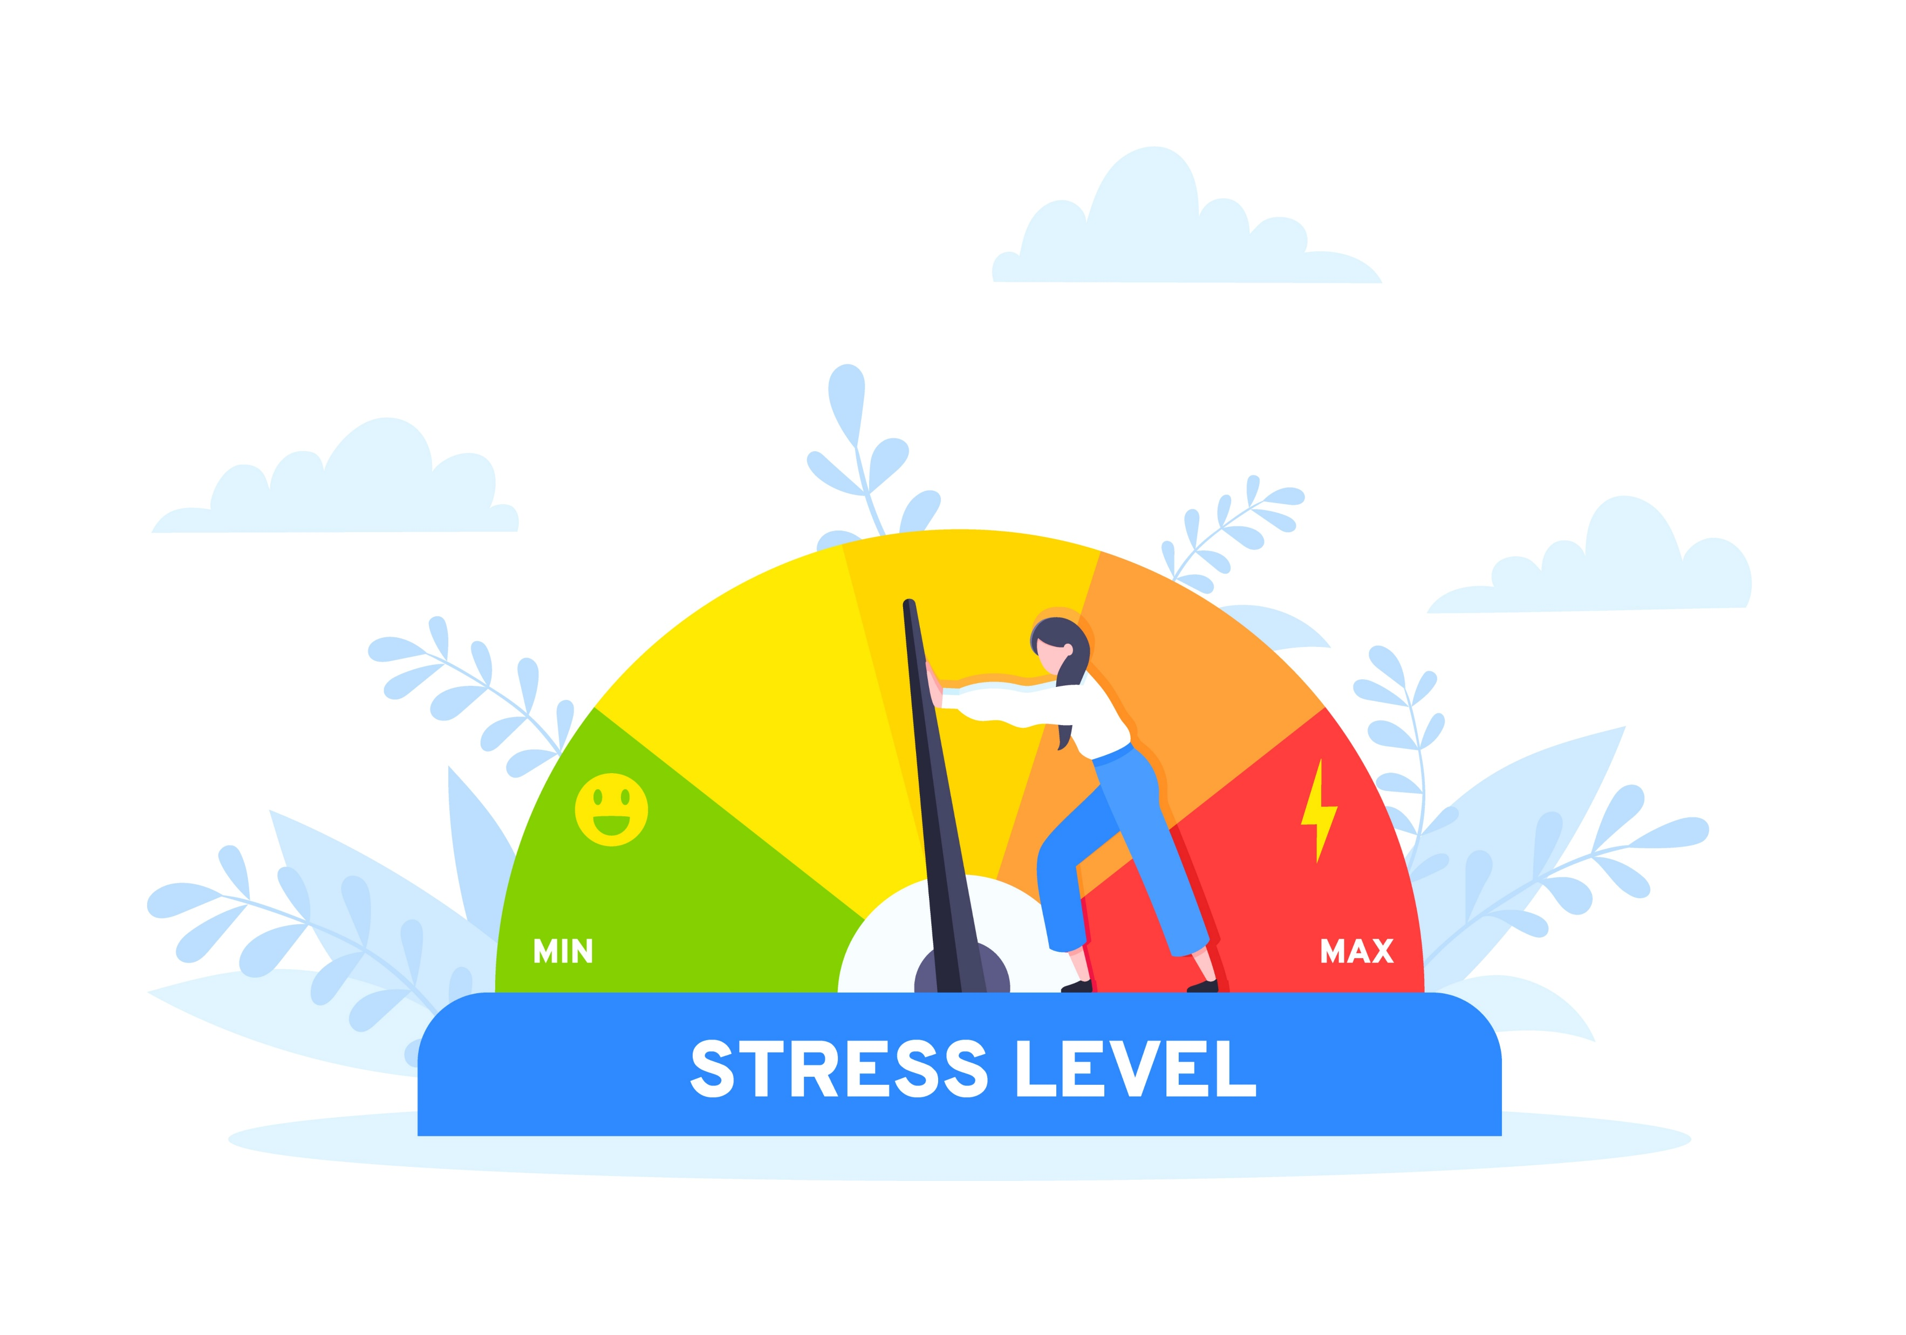
4.1
Monitor Own Stress Level

Slide 4
Disability support workers are at high risk of burnout. Some of the reasons behind this include the following:
Being underpaid
Limited authority to make decisions
Client behaviour (e.g. self-harm, aggression)
More negative work experiences compared to positive ones
Negative attitude towards client behaviour (e.g. being hostile or emotionally involved)
Implement Self-care Strategies

Slide 5
To avoid burnout, it is important that you also take care of your own health. The first thing you need to do is evaluate your well-being. This involves:
Observing yourself for signs and symptoms of stress
Asking yourself about your mental and emotional wellbeing
Implement Self-care Strategies

Slide 6
The following are some signs of stress:
Physical signs
Rapid breathing
Tensed muscles
Rapid heartbeat
Nausea or vomiting
Pain in certain body parts (e.g. chest, head, stomach)
Implement Self-care Strategies

Slide 7
The following are some signs of stress:
Emotional signs
Anger
Irritability
Restlessness
Unmotivated
Feeling overwhelmed
Implement Self-care Strategies

Slide 8
The following are some signs of stress:
Mental signs
Poor memory
Concentration difficulties
Poor decision-making skills
Constant negative thoughts
Sleeping problems
Implement Self-care Strategies

Slide 9
You may need to pause and reflect on your mental and emotional well-being. To check your mental and emotional well-being, you may also ask the following questions:
Do I easily get tired?
How often do I feel unmotivated?
Do I have negative thought patterns?
What triggers my negative thoughts or feelings?
Can I still handle workplace stress? Or is it too overwhelming?
Implement Self-care Strategies

Slide 10

4.2
Use Self-Care Strategies and Seek Support

Slide 11
Self-care refers to the practice of doing things to maintain one’s physical, emotional and mental well-being.
As a disability support worker, implementing self-care strategies will help you to cope with work-related stress.
These strategies may alleviate symptoms of stress. These may also help you recharge when you are demotivated about your work.
If your needs are taken care of, you can also better take care of your clients.
Implement Self-care Strategies

Slide 12
Some examples of self-care strategies are the following:
Exercising
Doing a hobby
Eating healthy food
Expressing gratitude
Yoga and meditation
Implement Self-care Strategies

Slide 13
Some examples of self-care strategies are the following:
Getting enough sleep
Having work-life balance
Asking for help when you need it
Spending time with family and friends
Affirming the positive things about yourself
Implement Self-care Strategies

Slide 14

Being a disability support worker is not an easy task. Seeking support is an opportunity for you to share your struggles with other people. These people may listen to you to lighten up the burden. They may also give you advice.
Implement Self-care Strategies

Slide 15
You can seek support by doing the following:
Talk to your family and friends – Talk to those who are likely the ones you trust the most. They will give unconditional support to help you cope with the mental and psychological difficulties you are facing. Talking about your work-related stress experiences with them may lighten up the burden.
Ask advice from your colleagues – They are the ones who can most likely relate to your experiences, thoughts and feelings. You can feel strong support from them.
Implement Self-care Strategies

Slide 16

You can seek support by doing the following:
Consult a professional – Particularly a mental health professional is best consulted in instances of mental health difficulties. They can diagnose, counsel you and treat psychological disorders.
Implement Self-care Strategies

Slide 17
The Work Health and Safety Act requires organisations to have workplace standards for hazards. It includes psychological risks. The legislation prescribes that a person conducting a business undertaking to:
Have policies and procedures that help protect the health and safety of their employees (including mental health and safety)
Provide relevant resources to protect their employees’ mental health
Implement Self-care Strategies

Slide 18
In line with the Work Health and Safety Act, your workplace may have the following resources and support:
Workplace counselling
Mental health toolkit
Seminars or workshops on stress management techniques
Implement Self-care Strategies

Slide 19

What have we learnt?
In this part of the session, we have covered:
Meet the job requirements of a disability support worker role.
Work within organisational requirements in disability support.
Work within a disability support context.
Implement self-care strategies.

Slide 20
End of Chapter 4

Slide 21

Presentation Objectives
Now that you have completed this presentation, you should be able to:
Meet the job requirements of a disability support worker role.
Work within organisational requirements in disability support.
Work within a disability support context.
Implement self-care strategies.

Slide 22
End of CHCDIS020 Presentation

Slide 23
Version Control & Document History
Date | Summary of Modifications | Version
11 January 2023 | Version 1.0 released for publishing | 1.0
14 April 2023 | Version 1.1 endorsed for use Minor revisions for improved readability | 1.1

